Slide 1
Secure data hiding in image using steganography
CAPSTONE PROJECT
Presented By: Akshay Raj
Student Name : Akshay Raj
College Name & Department : sardar patel university of
police,security &criminal justice, jodhpur (DOCAPS)

Slide 2
OUTLINE
Problem Statement
Technology used
Wow factor
End users
Result
Conclusion
Git-hub Link
Future scope

Slide 3
Problem Statement
Designing a secure steganography system to hide sensitive information within digital media.
Ensuring high embedding capacity , low distoration and robustness against detection.
Protect against unauthorized access and tampering.
Develop an efficient algorithm to embed and extract hidden data.

Slide 4
Technology used
Programming language used – python
Opertaing system – windows
Library used – CV2

Slide 5
Wow factors
Innovative use of technology
Real world relevance (Data security, practical applications)
Visual Appeal (image manuplation , before & after comparison)
Simplicity and accessibility
Potential for expansion

Slide 6
End users
End users can be the following:
Military
Security counsultant
An organization
Banking sector
Spies etc.

Slide 7
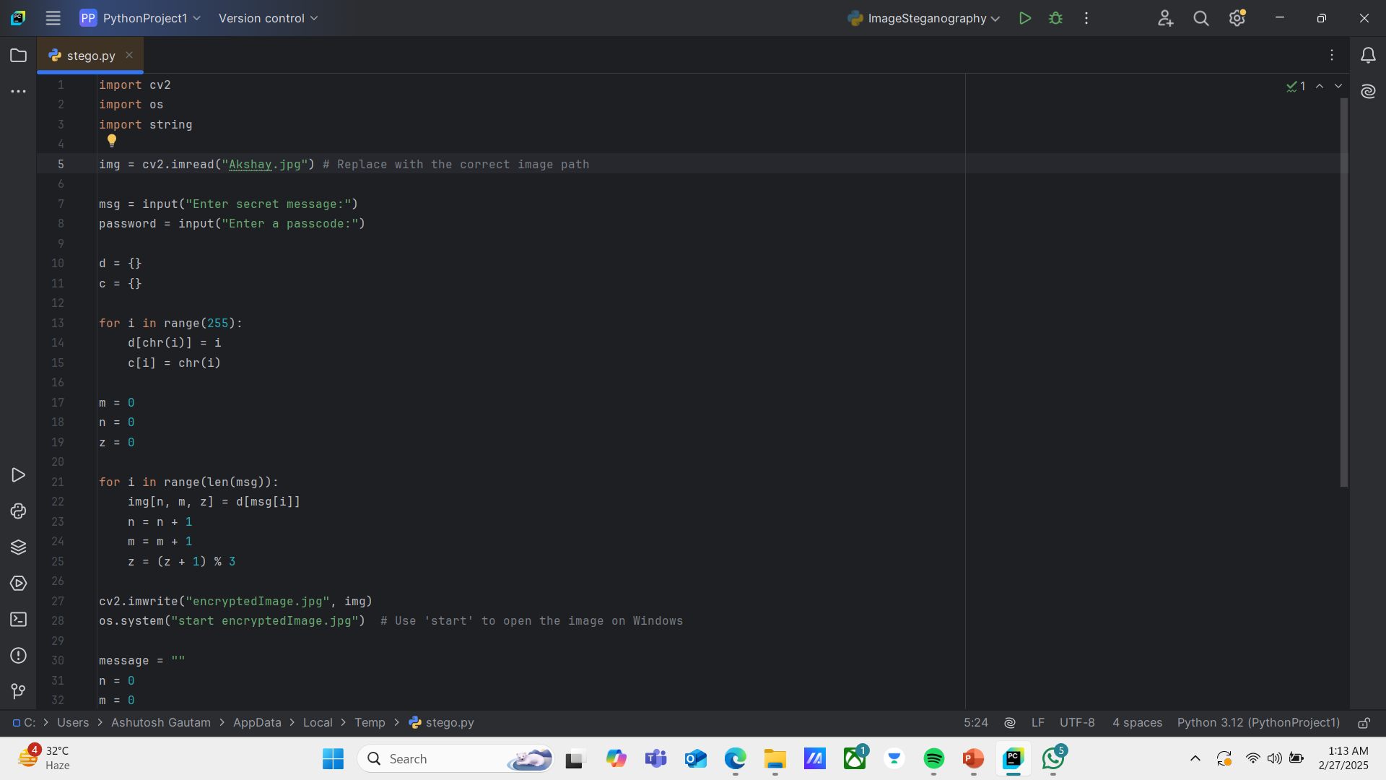

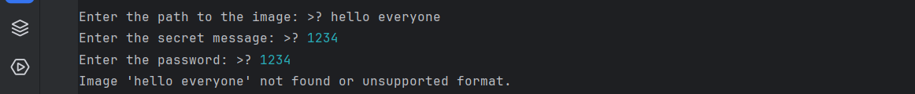
Results

Slide 8
Conclusion
Stenography is a vital skill that enables the rapid transcription of spoken words into written form. It is used across various fields including legal proceedings, media reporting, and office administration. This technique relies on specialized shorthand systems that significantly speed up writing processes compared to traditional longhand. Despite advancements in technology, stenography remains an indispensable tool for real-time documentation and verbatim record-keeping. Its precision, efficiency, and adaptability to different professional environments underscore its enduring relevance and importance.

Slide 9
GitHub Link
https://github.com/AKSHAY1ST/aicte-project.git

Slide 10
THANK YOU

